Slide 1
Collections
CMPE2300
Winter 2014
JD Silver

Slide 2
Collection Classes
There are many generic collection classes available in .NET.
Some collections perform better than others for certain tasks.
It is important to select the most suitable collection for the task.
Generic collections are able to hold any type of object, including value or reference types.

Slide 3
Collection Types
Collection | Description
Dictionary | A hash table of key/value pairs.
HashSet | A hash table of unique values.
LinkedList | A doubly linked list of values.
List | A vector of values.
Queue | A FIFO collection of values.
SortedDictionary | A Dictionary that is sorted by key.
SortedList | A binary search tree of key/value pairs.
Stack | A LIFO collection of values.

Slide 4
List
The List<> is the workhorse of the generic collection class.
Its internal implementation is as a vector (a managed array).
It provides random access to its elements via the indexer operator[].
Although it has good general performance, insertion and removal of elements at internal locations is not efficient.
Collections including List are considered Enumerable, which means that the collection can be iterated by a foreach loop.

Slide 5
List
A List is a reference type that will be created on the heap.
The type of data stored in the List is provided inside some angle brackets <>. // a list of ints List<int> nums = new List<int>(); // a list of a user-defined type List<CThing> things = new List<CThing>(); // a list of any type supporting IComparible List<IComparible> comps = new List<IComparible>();

Slide 6
List Operations
Some of the List operations include: Add, AddRange, BinarySearch, Clear, Contains, CopyTo, Exists, Find, FindAll, FindIndex, FindLast, FindLastIndex, GetRange, IndexOf, Insert, InsertRange, LastIndexOf, Remove, RemoveAll, RemoveAt, RemoveRange, Reverse, Sort, ToArray and TrueForAll.
In .NET 3.5 there are extension methods that include: Aggregate, All, Any, Average, Concat, Count, Distinct, Except, Intersect, Max, Min, Single, Sum, Take, and Union.

Slide 7
Add(object)
The Add() method adds an object to the end of the list.

Slide 8
BinarySearch( object )
This method assumes that the list has been previously sorted.
It returns the index if the element is found (which is not necessarily the first one in the list) or a negative value if the object is not found in the list.
If the list has not been previously sorted, it returns an incorrect result (and does not crash).
Equivalance requirements are included, so a reference type must override Equals for correct operation.

Slide 9
Clear( )
Clears the list of all contents.

Slide 10
Contains( object )
Returns true if the object argument is found in the list.
Returns false if the object could not be found in the list.
Equivalance requirements are included, so a reference type must override Equals for correct operation.

Slide 11
GetRange( )
Returns a new list consisting of the items in the range specified.

Slide 12
IndexOf( object )
Returns the index if the object is found in the list, otherwise, returns -1.
Equivalance requirements are included, so a reference type must override Equals for correct operation.

Slide 13
Insert( index, object )
Adds the object into the list at the specified index.
It will shift the other elements down if necessary.

Slide 14
Remove( object )
Removes the first occurrence of the object from the list.
Returns true if the operation was successful, false if the object was not found.
Equivalance requirements are included, so a reference type must override Equals for correct operation.

Slide 15
RemoveAt( index )
Removes the object found at the specified index.
Throws an ArgumentOutOfRange exception if the index is invalid.

Slide 16
RemoveRange( )
Removes the objects in the specified range.
Throws an ArgumentOutOfRange exception if the index is invalid.

Slide 17
Reverse( )
Reverses the order of the list, modifying the entire list.

Slide 18
Sort( )
Sort the list based on IComparable support.

Slide 19
Equivalence Considerations
The following methods perform their operation relying on the correctness/completeness of the contained object’s Equals() functionality.
Equivalence considerations can be ignored if the list contains value types, otherwise, for reference types Equals() must be considered.

Slide 20
Contains( object )
Returns true if the list has any element that is “Equals()” equivalent to the argument.

Slide 21
IndexOf( object )
Returns the index of the first element that is “Equals()” equivalent to the argument.
If the argument is not found, the method returns -1 indicating that it was not found in the list.

Slide 22
Remove( object )
Finds and removes the first element that is “Equals()” equivalent to the argument.
Returns true if a match was found, otherwise returns false.

Slide 23
BinarySearch( object )
Uses a binary search algorithm along with object Comparison to find a supplied argument in the list.
To use this method, the list must be sorted and provide a Comparison method to test whether list elements are less-than or greater-than another object.

Slide 24
Generic Extension Methods
Extension methods allow you to add new capabilities to a class without recompiling the class, or having access to it’s source code.
Generic extension methods use <> in their declaration, and there are several that have been defined for Collections.
These methods do not modify the list or their contents, but they return a new collection of type IEnumerable.
The return collection can be converted back to a List<> by using the ToList() method.

Slide 25
Concat( collection )
Generates a new collection that combines the argument collection to the invoking collection with possible duplicates.
For example: A.Concat( B ); results in a collection ordered as first the A elements then the B elements in their original order.
Uses deferred execution.

Slide 26
Distinct( )
Returns a new collection (of type IEnumerable) with duplicates removed.
It uses the overridden Equals() method of the collection object.
For example: DistinctList = AList.Distinct().ToList();
Uses deferred execution.

Slide 27
ElementAt( index )
Returns the collection element found at the index specified.

Slide 28
Except( collection )
Generates a new IEnumerable collection based on the invoking collection, without any elements of the argument collection.
Uses the element’s Equals() override for its operation.
For example: A.Except( B ); returns a collection with all elements in A that are not in B.
Uses deferred execution.

Slide 29
Intersect( collection )
Generates a new IEnumerable collection that is the common elements between the invoking collection and the collection argument.
For example… A.Intersect( B ); returns a new collection where the elements exist in both A and B collections.
Uses deferred execution.

Slide 30
Union( collection )
Generates a new IEnumerable collection that is the combination of both collections but without duplicates.
Uses deferred execution.

Slide 31
Deferred Execution
Concat(), Except(), Intersect(), Distinct() and Union() do not require pre-sorting of the collection, so they are not very efficient.
To reduce the overhead in execution of the operations, these implement a paradigm known as deferred execution.
Most of the processing is performed as the collection is being enumerated, such as in a foreach loop.

Slide 32
Creating Extension Methods
Extension methods extend the functionality of a class without the need to recompile the class, or have access to its source code.
Extension methods are created in a static class, and are static methods.
The parameter list includes the key word this, followed by the data type that is being extended.
The parameter which includes the word this is the invoking object for the method.

Slide 33
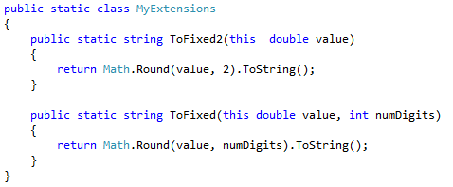
Creating Extension Methods

Slide 34
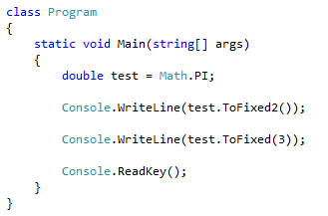
Creating Extension Methods

Slide 35
Comparison<>
Sorting user defined class instances requires the creation of a Comparison<> method.
The Sort() method supports a Comparison<> and a IComparer<T> interface.
The simplest approach is to supply a Comparison<> method to the Sort() method.
The method signature is shown below: [internal/public] static int MyCompare( type arg1, type arg2 )

Slide 36
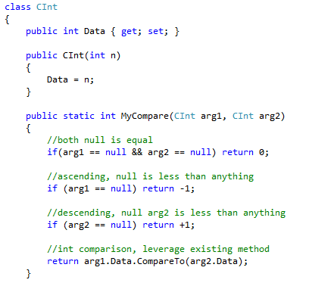
Comparison<>

Slide 37
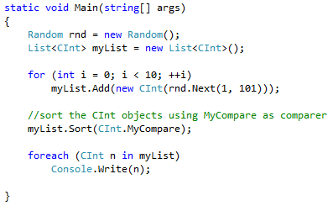
Comparison<>

Slide 38
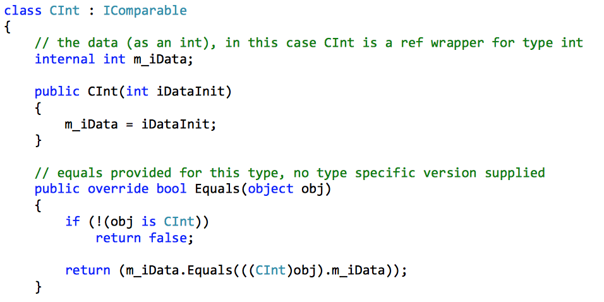
List Operations

Slide 39
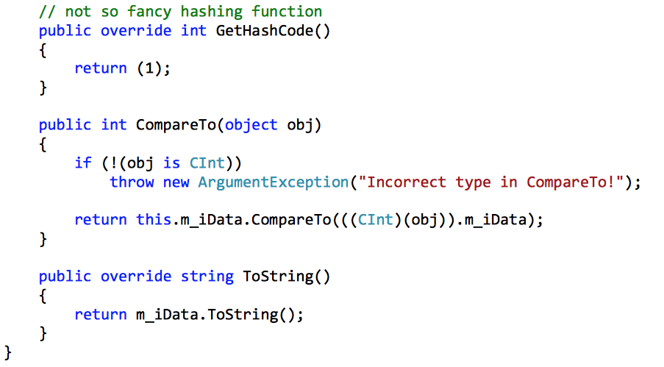
List Operations

Slide 40
List Operations - Add
The List type is a reference type, and requires allocation on the heap using the new operator.
The Add method will add the new element to the end of the List.
The Sort method will use the CompareTo method to sort the CInt objects.

Slide 41
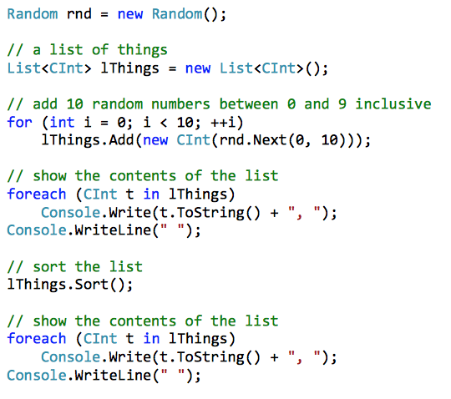
List Operations - Add
5, 3, 3, 2, 7, 8, 5, 8, 4, 3,
2, 3, 3, 3, 4, 5, 5, 7, 8, 8

Slide 42
List Operations - Sorting
The default Sort method will apply a quick sort to the items in the List, and requires that the contained type supports the IComparable interface.
The values will be sorted in ascending order.
If a different sorting order is desired, the Sort method contains an overload for IComparer<T>.
With this overload you may specify a type that implements the IComparer<T> interface to provide any desired comparison algorithm.

Slide 43
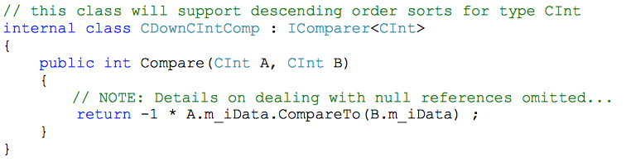
List Operations - Sorting

Slide 44

List Operations - Sorting
The class that was created would be specified in the call to the Sort method:
specifying the comparer allows you to create and use as many custom sorting algorithms as desired, while maintaining the standard IComparable behavior in the type.

Slide 45
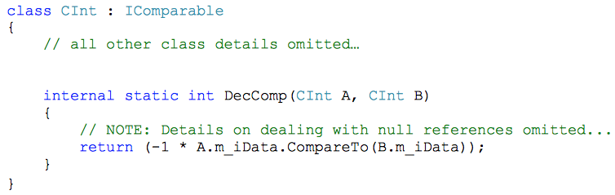
List Operations - Sorting
Another approach is to use a Comparison<T> function to provide a custom sort.
In this case, you would create a method that has the same functionality and signature as Compare in the IComparable<T> interface, except this method may be placed in the containing data type.

Slide 46

List Operations - Sorting
The call to Sort could then reference the sorting algorithm stored in the actual type that is contained in the list:

Slide 47
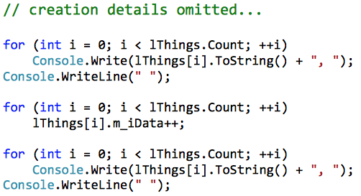
List Operations
The List collection allows access using array-like syntax with square brackets [].
The Count property indicates how many elements are stored in the List.

Slide 48
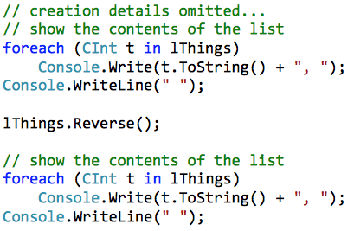
List Operations - Reverse
A list can Reverse its contents…
2, 3, 4, 1, 0, 1, 4, 7, 0, 7
7, 0, 7, 4, 1, 0, 1, 4, 3, 2

Slide 49
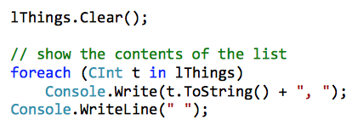
List Operations - Clear
A List can be cleared by using the Clear method.

Slide 50
List Operations - Searching
The BinarySearch method can be used to search for a value in a previously sorted List.
Attempting a BinarySearch on an unsorted List will not locate the desired value.
The return value is the index of the first found occurrence.
If the search value is not in the List, then a negative value is returned.
The negative value is the bitwise complement of the index that is the next item that is larger than the item that is sought.

Slide 51


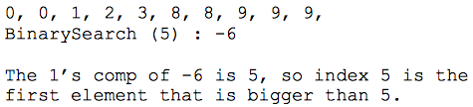
List Operations - Searching
Search for an instance of CInt with the value 5…
If the value is found…
If the value is not found…

Slide 52
List Operations - Searching
BinarySearch allows you to specify an IComparer compliant class.
The same comparer class should be used for sorting and searching.

Slide 53
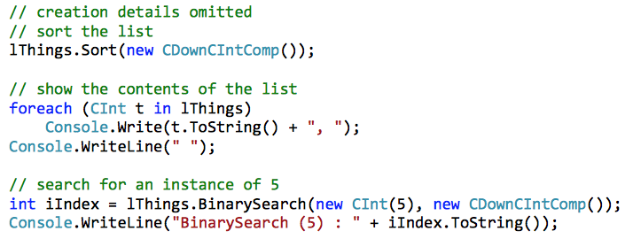
List Operations - Searching
8, 7, 6, 5, 4, 3, 2, 1, 0, 0,
BinarySearch (5) : 3

Slide 54
List Operations - Remove
The Remove method can be used to remove items from the List.
Remove will remove the first occurrence of an item from the List.
If an element was removed the method returns true, otherwise it returns false.
0, 1, 1, 2, 3, 4, 4, 8, 8, 9
True
0, 1, 1, 2, 4, 4, 8, 8, 9,

Slide 55

List Operations - RemoveAt
If an element index is known, RemoveAt can be used to remove the element.
3, 9, 6, 4, 9, 1, 6, 2, 4, 5
3, 9, 6, 4, 9, 6, 2, 4, 5

Slide 56
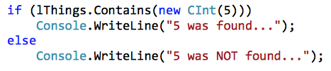
List Operations - Contains
The Contains method will determine if an element is in the list.
Contains use Equals to determine if an element is in the list using a linear search.
If found:
9, 8, 7, 5, 5, 5, 3, 2, 0
5 was found

Slide 57
List Operations - IndexOf
The IndexOf method returns the index of the located item, or -1 if it is not found.
0, 2, 3, 5, 5, 5, 7, 9, 9, 9,
IndexOf 5 : 3

Slide 58
List Operations - LastIndexOf
The LastIndexOf method will return the index of the last instance found, or -1 if it is not found.
0, 2, 3, 5, 5, 5, 7, 9, 9, 9,
IndexOf 5 : 5

Slide 59

Predicates
A predicate is a method that defines a set of criteria, and determines if an object meets that criteria.
In this course, predicates will return true or false, depending on the predicate criteria.
A predicate is defined within the class of the tested object.
The following static predicate will test if the data in CInt is odd or even.

Slide 60
Find with Predicate
Many operations in the generic collections use predicates as a selection criteria.
The Find method uses a predicate to locate the first item that meets its criteria.
If a matching element cannot be found, Find will return null for reference types, or the default value for value types.
1, 2, 3, 4, 5, 5, 7, 7, 7, 9,
Find Even : 2

Slide 61
FindLast with Predicate
The FindLast method works just like Find, except it locates the last matching element.
2, 9, 4, 5, 4, 2, 9, 7, 6, 7
Find Last Even : 6

Slide 62
FindIndex with Predicate
The FindIndex method uses a predicate to locate the first matching element, and returns the index of the matching element.
If a matching element could not be found, then -1 is returned.
1, 2, 3, 3, 4, 6, 8, 9, 9, 10
Found an even value at index : 1

Slide 63
FindLastIndex with Predicate
The FindLastIndex method works just like FindIndex, except it finds the last matching element.
5, 9, 8, 6, 9, 8, 7, 5, 6, 2
Found last even value at index : 9

Slide 64

FindAll with Predicate
The FindAll method returns all of the value that match the predicate in a new List<T>.
0 is even!
2 is even!
4 is even!
6 is even!
8 is even!

Slide 65
RemoveAll with Predicate
The RemoveAll method will remove all the elements that match a predicate’s criteria, returning the number of elements removed.
0, 2, 9, 0, 0, 8, 2, 3, 1, 2
Removed : 7 elements
9, 3, 1

Slide 66
Exists with Predicate
The Exists method is similar to Contains, except a predicate is used to determine if any of the elements are a match.
If an element is found to exist, the return value is true, otherwise it is false.
1, 2, 3, 4, 5, 6, 7, 8, 8, 9
Do Evens Exist : true

Slide 67
TrueForAll with Predicate
The TrueForAll method returns true is all elements in the list meet a predicate’s criteria.
8, 0, 8, 6, 7, 5, 9, 2, 1, 6
All elements are even : False

Slide 68
Lamda Expressions
Predicates are simply a system-defined delegate:
Anything that wants a predicate wants a method that matches the delegate form.
In the case of a predicate, this means a target method that returns a bool and accepts an instance of the type being checked by the predicate.

Slide 69
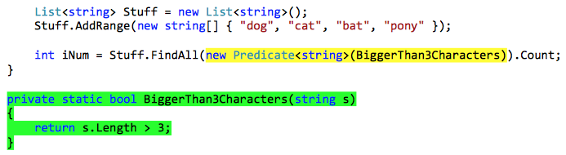
Lamda Expressions
The predicate, being a delegate, may be created as a formal and complete delegate instance:
The language allows for a shorter form:

Slide 70
Lamda Expressions
The need to create a separate method can be extra overhead, especially if the method is only used once.
C# supports a mechanism known as anonymous methods.
By using an anonymous method, the creation of a target method can be skipped and an inline version can be used.

Slide 71
Lamda Expressions
An extension of anonymous methods for use with delegates is the lambda expression, which uses the new C# operator => .
This operator uses arguments to the left of the lambda operator and statements that manipulate the arguments to the right of the lambda operator.
The language uses context and the expected delegate type to deduce argument types as well as the return values.
By using the lambda operator, the previous example can be simplified:

Slide 72
Lamda Expressions
Since the underlying delegate in the FindAll call is expecting a method that accepts a string, it may be deduced that the s to the left of the lambda operator is a string variable.
The expression to the right results in a bool, so it is deduced that a bool is the return value.

Slide 73
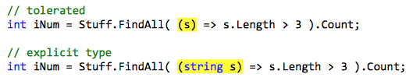
Lambda Expressions
A lambda expression may explicitly indicate the argument types by placing them in round brackets to the left of the lambda operator.
This is also permitted if the data type is being deduced.

Slide 74
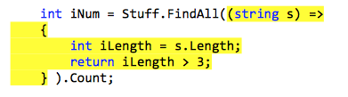
Lambda Expressions
Multiple statements may be included in the statements portion of the lambda expression:

Slide 75
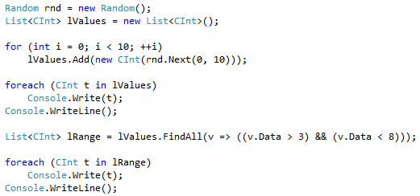
Lambda Expressions
The FindAll method returns a List<>, which will contain the objects which match the lambda expression.
2, 0, 1, 2, 8, 2, 6, 5, 5, 1,
6, 5, 5,

Slide 76
Insertion and Ranges
The Add method adds a new item to the end of the list.
If you need to insert a new item at any other position, the Insert method will insert a new element at the index specified.
3, 4, 0, 0, 8, 1, 5, 4, 6, 2,
3, 4, 0, 0, 8, 100, 1, 5, 4, 6, 2

Slide 77
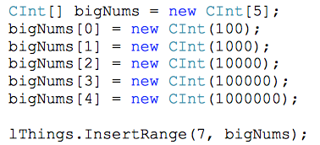
Insertion and Ranges
If you want to insert a number elements at a position, the InsertRange method will insert elements from anything that is enumerable.
6, 2, 1, 6, 8, 3, 4, 4, 5, 7,
6, 2, 1, 6, 8, 3, 4, 100, 1000, 10000, 100000, 1000000, 4, 5, 7

Slide 78
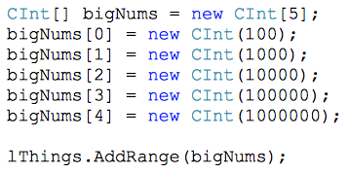
Insertion and Ranges
The AddRange method adds a range of elements to the end of the list.
8, 8, 4, 8, 4, 0, 3, 6, 6, 0
8, 8, 4, 8, 4, 0, 3, 6, 6, 0, 100, 1000, 10000, 100000, 1000000

Slide 79
Extension Methods
The extension methods that were implemented in .NET 3.5 allow for even more sophisticated operations.
Extension methods allow you to "add" methods to an existing type without creating a new derived type, recompiling, or otherwise modifying the original type.

Slide 80
Distinct
The Distinct extension method will return an enumerable interface of unique values from the list.
Distinct returns an IEnumerable interface that can be converted back to a List by calling the ToList method.
7, 2, 0, 9, 8, 6, 3, 3, 2, 3,
7, 2, 0, 9, 8, 6, 3,

Slide 81
Distinct
Distinct makes use of the Equals and GetHashCode methods to determine what values are unique.
The better the hashing algorithm in GetHashCode the fewer calls to Equals.
A GethashCode method that returns 1 will resolve distinctness almost entirely with Equals, while a perfect GetHashCode method will resolve distinctness almost entirely using GetHashCode.

Slide 82
Concat
The Concat extension method will return an IEnumerable interface that is the concatenation of the invoking collection and a supplied sequence collection.
This method is very similar to AddRange, except no collections are modified, and the return value is an interface.
As with Distinct, the returned interface can be turned into a list with a call to ToList:

Slide 83
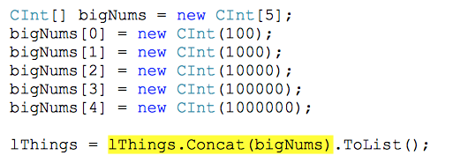
Concat
3, 9, 7, 2, 0, 9, 0, 0, 2, 6,
3, 9, 7, 2, 0, 9, 0, 0, 2, 6, 100, 1000, 10000, 100000, 1000000

Slide 84
Except
The Except extension method will return an enumerable interface that contains the unique elements in the invoking collection that are not in a provided collection.
Since Except takes any enumerable interface, any sequence collection will do:
7, 4, 7, 4, 5, 5, 9, 3, 6, 1,
7, 5, 9, 3, 1,

Slide 85
Intersect
The Intersect extension method will produce an enumerable interface of unique elements that exist in the invoking collection and a provided sequence collection:
A: 6, 4, 7, 7, 3, 8, 4, 7, 9, 2,
B: 6, 0, 4, 4, 7, 0, 3, 5, 8, 6,
Result: 6, 4, 7, 3, 8,

Slide 86
Union
The Union extension method will provide an enumerable interface that is the set union between the invoking instance and another sequence collection.
The resultant collection will be a distinct set of the elements from both collections:
A: 4, 3, 3, 0, 8, 7, 2, 1, 1, 2,
B: 3, 6, 8, 4, 1, 3, 4, 9, 1, 7,
Result: 4, 3, 0, 8, 7, 2, 1, 6, 9

Slide 87
Extension Methods Using Func
There are several extension methods that use the Func delegate type as well, and in many cases, the Func delegate is used as a predicate.
The Func delegate type is admittedly more complicated than using predicates, but if you can learn them, the benefit of the additional functionality you can leverage is significant.
The Func delegate has seventeen different forms, so the precise type you will use depends on the usage.
Interesting enough, the simplest form of the Func delegate is directly compatible with the Predicate delegate, and therefore may use the same target methods.

Slide 88
Aggregate
One of the simplest extension methods requiring the Func delegate is Aggregate.
The Aggregate method expects a target method that will accept an aggregation value and an element instance.
The first call will contain the first element as the aggregation value, and the second element as the element.
Subsequent calls will contain the aggregate of the operation and the next element in the collection until all values have been visited:

Slide 89
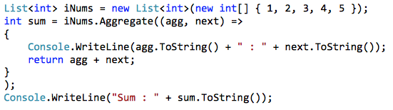
Aggregate
This sample use of Aggregate produces the sum of the elements in the collection.
1 : 2
3 : 3
6 : 4
10 : 5
Sum : 15

Slide 90

Sum
The Sum extension method provides the sum of the elements in a collection.
A lamba may be provided for further processing.
30

Slide 91

Min
The Min extension method provides the minimum value of a set of elements.
1

Slide 92
Min
The Min extension method can also use the lambda operator.
In this example, a list of strings will be evaluated for the name with the minimum length.
2

Slide 93
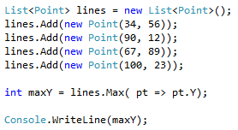
Max
The Max extension method determines the maximum element in a collection.
In this example, Max can be used with the lambda operator to evaluate a property of a class, namely, the Point class.
89

Slide 94
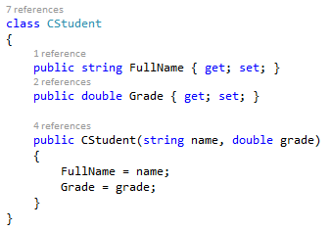
Average
The Average extension method calculates the average of a set of elements in a collection.
In this example, Average will be used to calculate the average grade of the list of students.

Slide 95
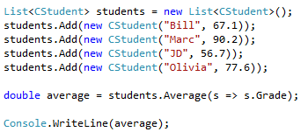
Average
The lambda operator is used to specify the property for which the average will be calculated.
72.9

Slide 96
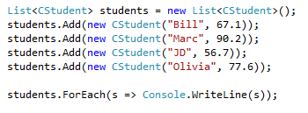
ForEach
The ForEach extension method performs the specified action on each element of the List<T>.
In the example shown below, ForEach is used to display the name and grade for all students in the list.
Bill : 67.1
Marc : 90.2
JD : 56.7
Olivia : 77.6

Slide 97
Queue
The queue is a collection that operates as a FIFO (First In, First Out).
The queue makes use of Enqueue, Dequeue and Peek.
Enqueue will add an object to the end of the queue.
Dequeue will remove an object from the front of the queue.
Peek allows you to see the next value in the queue without altering the queue.
The Queue collection also supports many of the extension methods found in the List.

Slide 98
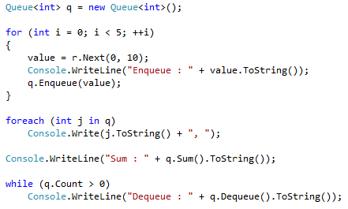
Queue
Enqueue : 0
Enqueue : 8
Enqueue : 6
Enqueue : 8
Enqueue : 9
0, 8, 6, 8, 9, Sum : 31
Dequeue : 0
Dequeue : 8
Dequeue : 6
Dequeue : 8
Dequeue : 9

Slide 99
Queue
The queue does not support indexing or sorting.

Slide 100
Stack
The Stack is a collection that operates as a LIFO (Last In, First Out).
The Stack type is enumerable, but does not support indexing or sorting.
Values are added to the top of the stack with Push.
Values are removed from the top of the stack with Pop.
The Peek method will allow the program to look at the top of the stack without modifying the stack.
Stacks are enumerated from the top of the stack to the bottom of the stack.

Slide 101
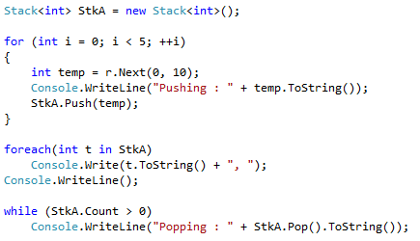
Stack
Pushing : 9
Pushing : 4
Pushing : 0
Pushing : 3
Pushing : 7
7, 3, 0, 4, 9,
Popping : 7
Popping : 3
Popping : 0
Popping : 4
Popping : 9

Slide 102
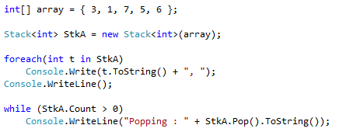
Stack
Most collections have a constructor overload that will allow you to build the object from any sequence container.
For example, a Stack may be created from an array or a List.
6, 5, 7, 1, 3,
Popping : 6
Popping : 5
Popping : 7
Popping : 1
Popping : 3

Slide 103
LinkedList
The LinkedList is a collection which contains a series of nodes that are connected linearly by references.
In the C# implementation of a linked list, each node contains two references, one pointing to the node before, and one pointing to the node after the current one.
Next
LinkedListNode
Data
Last
First
Data
Data
Previous

Slide 104
LinkedList
The LinkedList is implemented as a doubly linked list of LinkedListNode objects.
The LinkedListNode object contains the data to be stored (as a reference), a reference to the previous node in the list, and a reference to the next node in the list.
If the node is at the end of the linkedlist, then the Next reference will contain a null value.
If the node is at the beginning of the linkedlist, then the Previous reference will contain a null value.

Slide 105
LinkedList
Insertion of new nodes at the front or the back of the linked list is a fast operation, regardless of the number of nodes in the list.
Linked lists have an advantage over the vector (List<>) due to the speed of adding new nodes at the beginning or the end of the list.
Disadvantages of the linked list are the need for list traversal, the inability to sort, and the absence of indexing.
The [ ] brackets cannot be used to access a location in the linked list.

Slide 106
LinkedList Add Remove Nodes
Method | Purpose
AddAfter() | Adds a value to a new node after the one specified in the method
AddBefore() | Adds a value to a new node before the one specified in the method
AddFirst() | Adds a node to the beginning of the linked list
AddLast() | Adds a node to the end of the linked list
Remove() | Removes a node from the linked list
RemoveFirst() | Removes the first node from the linked list
RemoveLast() | Removes the last node from the linked list

Slide 107
LinkList Properties
Property | Purpose
First | Reference to the first node in the list
Last | Reference to the last node in the list
Count | The number of nodes in the list

Slide 108
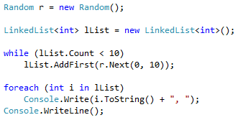
LinkedList
The following example creates a linked list of random values:
8, 9, 0, 1, 7, 0, 0, 8, 4, 8,

Slide 109
LinkedListNode
The LinkedListNode class provides each node of a linked list.
It contains a reference to the value stored in the node, and member variables to contain references to the next node in the list, and the previous node in the list.

Slide 110
LinkedListNode Properties
Property | Purpose
Next | Reference to the next node in the linked list
Previous | Reference to the previous node in the linked list
Value | Reference to the data stored in the linked list node
List | Reference to the linked list to which the node belongs

Slide 111
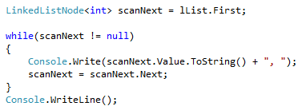
Traversing a Linked List
A reference to a linked list node can be used to traverse a linked list:

Slide 112
Traversing a Linked List
The reference variable scanNext refers to a linked list node.
It is initially assigned with a reference to the beginning of the linked list.
Linked list traversal will end when the last node is encountered, which is indicated by a null value in the Next member of the node.
A while loop continues looping until the value of scanNext is null.
The value of scanNext is assigned the reference stored in the Next member of the currently referenced node.

Slide 113
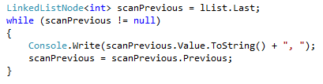
Traversing a Linked List
The following code will traverse a linked list in reverse:

Slide 114
HashSet
A HashSet holds a set of objects, but in a way that it allows you to easily and quickly determine whether an object is already in the set or not.
It does so by internally managing an array and storing the object using an index which is calculated from the hashcode of the object.
A HashSet is an unordered collection containing unique elements.
It has the standard collection operations Add, Remove, Contains, but since it uses a hash-based implementation, these operation are O(1).

Slide 115
HashSet
HashSet also provides standard set operations such as union, intersection, and symmetric difference.
The HashSet class in C# makes insertion and lookup operations fast by hashing the elements, which means that the order of the elements not preserved.
A HashSet cannot be indexed by using the [ ] operator.

Slide 116
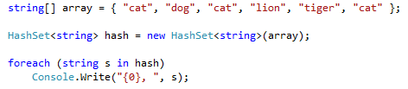
HashSet
In the following example, a HashSet of strings is created from an array of strings:
cat, dog, lion, tiger

Slide 117
HashSet
The HashSet has high performance for data types that support a quality Equals and GetHashCode implementation.
For atomic types that already support these methods properly or when appropriately used in complex user-defined types, excellent performance can be found with the Contains method.
Conversely, for types that poorly implement Equals, and especially GetHashCode, performance will suffer.
Since a HashSet contains unique values, adding duplicate values will fail.

Slide 118
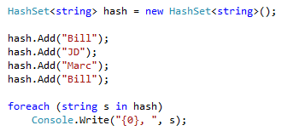
HashSet
In the following example, adding a duplicate string to a HashSet fails:
Bill, JD, Marc

Slide 119
HashSet Performance
If the HashSet is being used to store a user defined data type then performance will depend on the quality of the implementation of GetHashCode().
In the following example, the performance difference between a List<> and a HashSet<> is measured, when using different versions of GetHashCode.
The class CThing will be used to create objects that are stored within a List<CThing> and a HashSet<CThing>.
The performance for accessing the CThing objects will be compared between the List and the HashSet, for different implementations of GetHashCode().

Slide 120
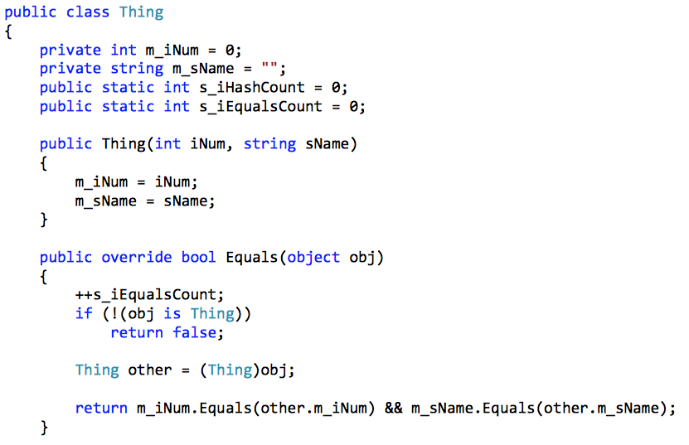
HashSet Performance

Slide 121
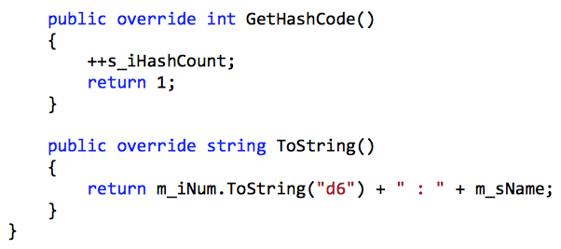
HashSet Performance
This class has a poorly implemented version of GetHashCode; always returning the value of 1.

Slide 122
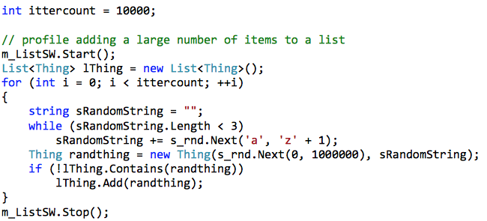
HashSet Performance
The main program will profile adding a large number of items to a list and a hashset, comparing the number of Equals and GetHashCode calls that are required.

Slide 123
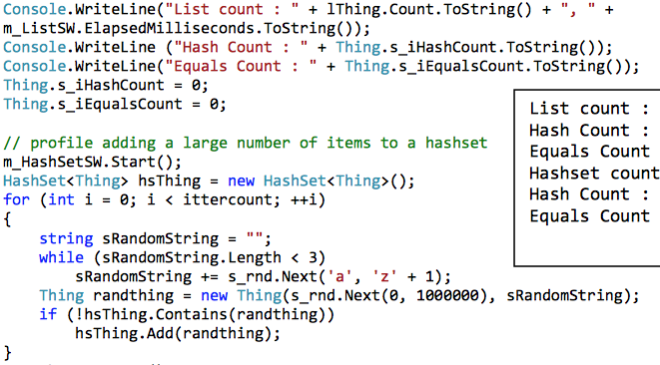
HashSet Performance

Slide 124
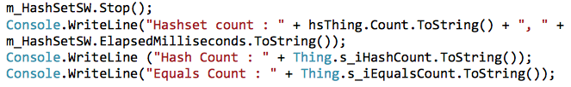
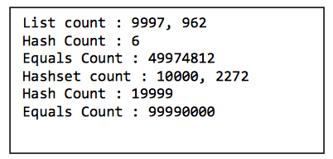
HashSet Performance

Slide 125
HashSet Performance
As the stats show, the HashSet took more than twice as long to perform the same operation as the List.
HashSet relies on GetHashCode to differentiate elements, and without it, it must fall back to Equals.
If GetHashCode fails to provide useful information HashSet is very inefficient.

Slide 126
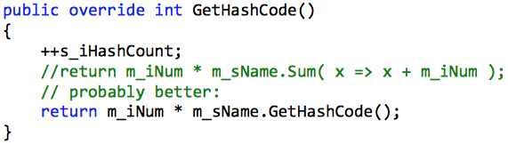
HashSet Performance
If GetHashCode returns useful information, HashSet performs quite well:
Instead of twice as long, HashSet took 1/500th the time to do the same thing...

Slide 127
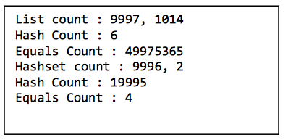
HashSet Performance

Slide 128
Dictionary
The Dictionary class associates keys and values.
Values are accessed in the Dictionary through the key, and access is typically very fast as the Dictionary is implemented with a hash table.
It is important that the hashing algorithm in the key be first-rate, as the performance of this collection greatly depends on it. Keys within the dictionary must be unique.

Slide 129
Dictionary
Each logical element in a Dictionary is considered a KeyValuePair.
The KeyValuePair structure represents the key and its associated value.
Enumerating a Dictionary returns these elements in no particular order, but traversal typically follows order of addition.

Slide 130
Dictionary
A Dictionary is declared by providing the key data type followed the value to be stored.
The key value can be any data type, as long as it has a suitable hashing and equality implementation.
In the following example, a string is used as the key value (like an index to an array) and the value is integer.

Slide 131

Dictionary
The Add method can be used to add an element to a dictionary.
In the following example, names are used as the key value, and an integer mark is the value.

Slide 132
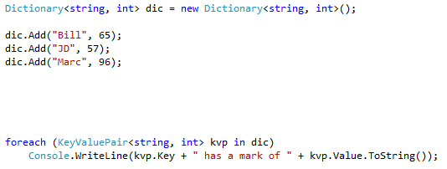
Dictionary
A Dictionary can be enumerated using a foreach loop.
Each value in the Dictionary is a KeyValuePair<> from which the key or the value can be extracted.
Bill has a mark of 65
JD has a mark of 57
Marc has a mark of 96

Slide 133
Dictionary
The key value can be used as an index in [ ] for setting and getting values.
The index is added to the dictionary if you attempt to write to a key that does not exist.
If you attempt to read from a key that does not exist an exception is thrown.

Slide 134
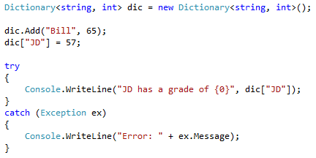
Dictionary
In the example below, the string "JD" is used as an index to the dictionary:

Slide 135
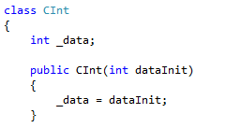
Dictionary
The properties Keys and Values return collections of those items.
In the following example, the dictionary contains a class named CInt.
The CInt class contains a single integer value.

Slide 136
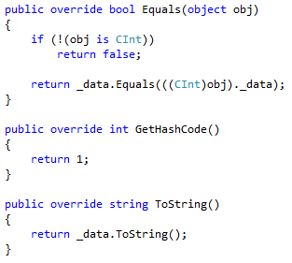
Dictionary

Slide 137
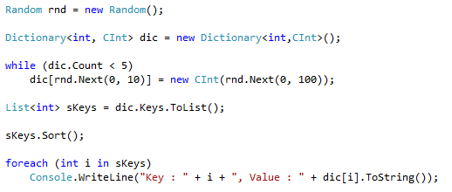
Dictionary
In this example, the key values are converted to a List<int> and sorted:
Key : 0, Value : 66
Key : 1, Value : 11
Key : 3, Value : 63
Key : 4, Value : 45
Key : 9, Value : 83

Slide 138
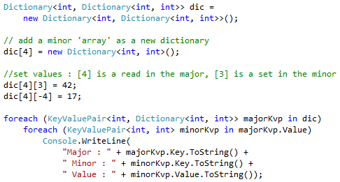
Dictionary
When a dictionary is used to hold a collection that can be indexed (especially another dictionary), the syntax begins to eerily look like the collection set is a 2D array:
Major : 4 Minor : 3 Value : 42
Major : 4 Minor : -4 Value : 17

Slide 139

Predicates and KeyValuePair
The regular operations and extension methods for the Dictionary work much as they do for other containers, except the elements are presented as instances of KeyValuePair.
If, for example, you wanted to write a predicate function for removing dictionary entries that had odd numbers, it might look like this:

Slide 140
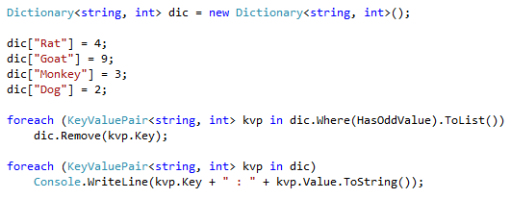
Predicates and KeyValuePair
The predicate function is used to remove all elements of the dictionary where the value is odd:
Rat : 4
Dog : 2

Slide 141

Extension Methods
The Aggregate extension method, for example, is a very flexible method that can apply a System.Func delegate to each element of a container while passing cumulative values to the delegate function:

Slide 142

Extension Methods

Slide 143

Lambda Expressions
Lambda expressions can be used with a Dictionary; the operations tend to work on KeyValuePair<> elements.
JD,Bill,Marc, 239

Slide 144

Lambda Expressions
A selection predicate can be used with a lambda expression and a dictionary.
JD has a mark < 60

Slide 145
Creating Extension Methods
Extension methods may be created to add additional functionality to existing types.
Extension methods are typically a last resort for providing additional behavior to a type, as the mechanism can be susceptible to failure if the underlying type changes.
Inheritance or code versioning are better solutions that extension methods, but there are circumstances when extension methods are beneficial.
Extension methods are implemented as static methods typically in a static class.

Slide 146
Creating Extension Methods
The following static class illustrates how the CDrawer type may be extended to include a white background clearing method and a bitmap rendering method:

Slide 147

Creating Extension Methods

Slide 148

Creating Extension Methods
The extension methods use the ‘this’ keyword as a modifier in the first argument.
This argument becomes a hidden field that is the type being extended.
From a caller perspective, the static extension method appears to be a non-static method in the extended type:

